Slide 1
PLAIN GAME
Computer Graphics

Slide 2
Our Team Member
Instructor | Name | ID
TANJINA ORIANA | ABU TAHER RASEL | 23305002
 | RABBI BISWAS | 21305021
 | FATEMA AKTER | 20104029
 | Jannatun Ferdows | 20104010
 | Musfiqur Rahman | 20104026

Slide 3
INDEX
Introduction
Project Details
Project view
Project Source

Slide 4
Introduction
In our plain game project, first, we worked in 2 files, in our main file all objects and all designs are worked. In another file, we have created some color models of the colors that we will use for the whole design so that we can easily design our main file using any color code.

Slide 5
Project Details
All files including
Window objects create
Drawing side building and other elements
Drawing road
Drawing circle
Drawing plan body
Complete environment setup (total window)
Key setup
Project run
End

Slide 6
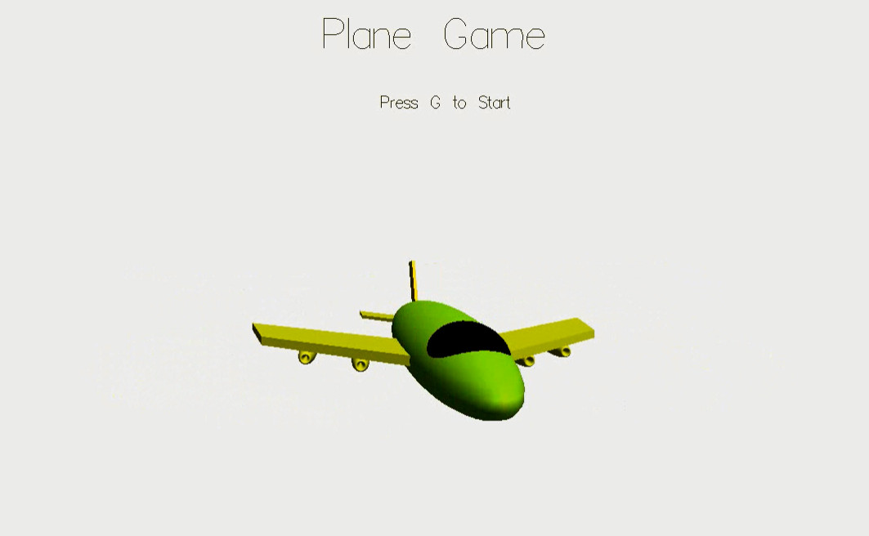
Project View

Slide 7
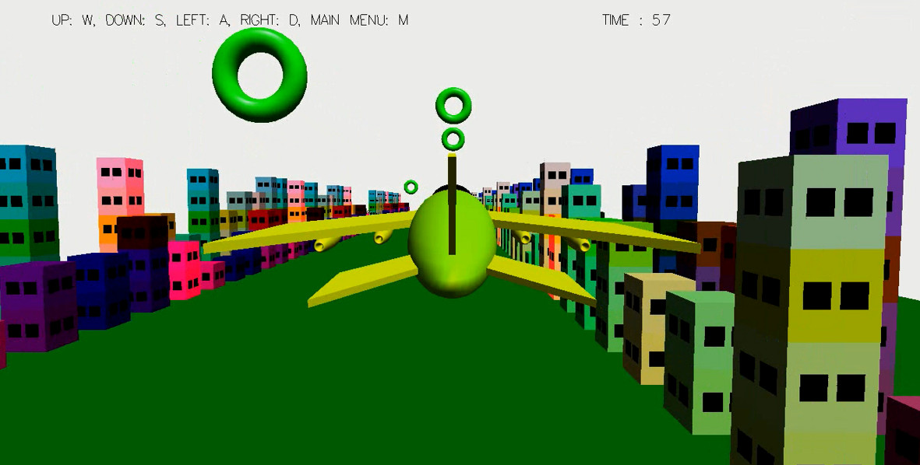
Project View

Slide 8
Source Code with Github
Source code: https://github.com/Raselmd/Glute-Plane-Game.git

Slide 9
Thank You

